Slide 1

ITAI 1371 Module 04
Working with Data & Exploratory Data Analysis (EDA)
Introduction to Machine Learning
Module 04
Working with Data & EDA (2026 Edition) • Classic ML

Slide 2





Agenda
Why data quality matters (garbage in, garbage out)
Understanding your data (types, distributions, patterns)
Visualization techniques for insights
Identifying data quality issues
EDA best practices & workflow
Module 04
Working with Data & EDA (2026 Edition) • Classic ML

Slide 3
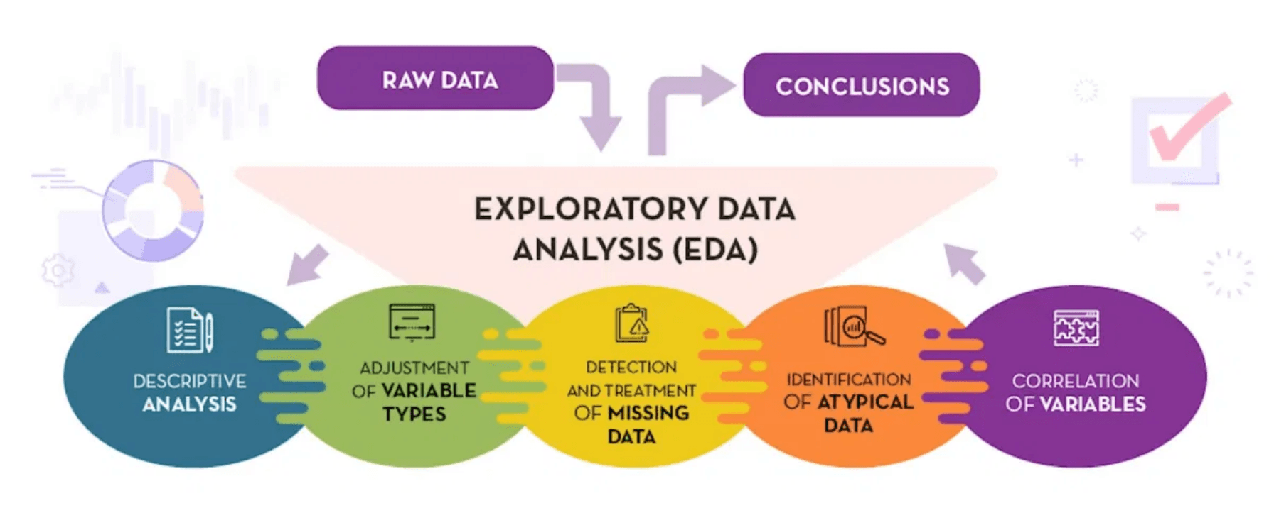
Why EDA Matters
•
ML models learn from
data patterns
•
Bad data = bad predictions (no matter how good your model)
•
EDA reveals:
–
Missing values and outliers
–
Feature relationships and correlations
–
Data distribution and balance
•
Prevents costly mistakes before training
•
Guides feature engineering decisions
Module 04
Working with Data & EDA (2026 Edition) • Classic ML

Slide 4
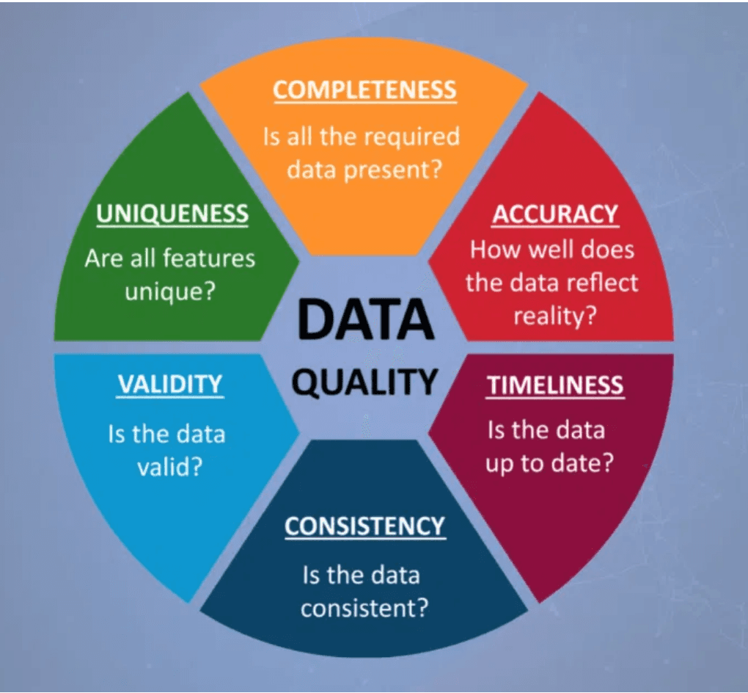
The Data Quality Problem
•
Real-world data is messy:
–
80% of ML work
is data preparation
–
Missing values (sensors fail, users skip fields)
–
Duplicates (data entry errors)
–
Outliers (typos: age = 999, or genuine extremes)
–
Inconsistent formats (dates, categories)
•
You can't skip this step
•
EDA is your
detective work
phase
Module 04
Working with Data & EDA (2026 Edition) • Classic ML

Slide 5
Types of Data
Numerical
Categorical
Quantitative Data
Qualitative Data
Continuous: age, salary, temperature
Nominal: color, country, product type
Discrete: purchase counts, item counts
Ordinal: education level, 1–5 star rating
Text
DateTime
Unstructured Data
Temporal Data
Reviews, descriptions, social media posts, emails, documents
Timestamps, dates, time series
Module 04
Working with Data & EDA (2026 Edition) • Classic ML

Slide 6
Why Data Types Matter
•
Different types need different handling:
–
Numerical:
can calculate mean, standard deviation
–
Categorical:
need encoding (one-hot, label)
–
Text:
requires tokenization, vectorization
•
Wrong treatment =
poor model performance
•
Example: treating ZIP code as numerical (Wrong! It's categorical)
Always check data types first:
df.dtypes
Module 04
Working with Data & EDA (2026 Edition) • Classic ML

Slide 7
Step 1: Initial Data Inspection
•
Load and preview the data
–
First/last rows:
df.head()
,
df.tail()
–
Shape: how many rows and columns?
df.shape
–
Column names and types:
df.info()
•
Check for obvious issues:
–
Are column names clear and consistent?
–
Do data types make sense? (e.g., is Price a number?)
–
Any immediate red flags in the preview?
Module 04
Working with Data & EDA (2026 Edition) • Classic ML

Slide 8
Step 2: Summary Statistics
Numerical Features
Categorical Features
•
Mean, median, min, max, std dev
•
Unique values count
•
Most frequent categories
•
Quartiles (25%, 50%, 75%)
Pandas Command:
Pandas Command:
df['column'].value_counts()
df.describe()
Module 04
Working with Data & EDA (2026 Edition) • Classic ML

Slide 9
Step 3: Missing Values Analysis
1. Quantify the Problem
•
How much data is missing? (Count vs Percentage)
•
Pandas check:
df.isnull().sum()
•
Visual check: Heatmap of missing values
2. Analyze Patterns
•
Random?
(MCAR: Missing Completely at Random) - Safe to drop?
•
Systematic?
(MNAR: Missing Not at Random) - e.g., High income users skip "Salary" field
•
Dependent?
(MAR: Missing At Random) - Missingness depends on other observed data
3. Make a Decision
Drop
OR
Impute
OR
Flag
Module 04
Working with Data & EDA (2026 Edition) • Classic ML

Slide 10
Handling Missing Values
Drop
Impute
Flag
If < 5% missing & random
Fill in the gaps
Create indicator
•
Remove rows (if data is ample)
•
Numerical:
•
Add column: "was_missing"
Mean or Median
•
Remove columns (if > 50% missing)
•
Categorical:
Mode
•
Preserve missingness info
•
Time series:
fwd/back fill
•
Risk: lose information
•
Model can learn from missingness
Context matters: Always ask "Why is this data missing?" before choosing a strategy.
Module 04
Working with Data & EDA (2026 Edition) • Classic ML

Slide 11
Step 4: Outlier Detection
•
Outliers = extreme values far from others
•
Detection methods:
–
Visual:
box plots, scatter plots
–
Statistical:
Z-score (> 3 std devs)
–
IQR method:
Q1 - 1.5×IQR
,
Q3 + 1.5×IQR
Critical Questions to Ask
?
Is this a data error or a genuine extreme value?
?
Should I keep, cap, or remove it?
Module 04
Working with Data & EDA (2026 Edition) • Classic ML

Slide 12
Step 5: Distribution Analysis
•
Understand how data is spread:
–
Normal (bell curve)?
–
Skewed (long tail left or right)?
–
Uniform, bimodal, multimodal?
•
Visualize with
histograms
and
density plots
Why It Matters
• Some models assume normality (e.g., Linear Regression)
• Skewed data may need transformation (Log, Box-Cox) to perform well
Module 04
Working with Data & EDA (2026 Edition) • Classic ML

Slide 13

Step 6: Correlation & Relationships
Correlation Coefficient (r)
-1.0
Negative
0.0
None
+1.0
Positive
Use df.corr() to generate the matrix
•
Visualize with sns.heatmap()
•
⚠️ Watch Out: Multicollinearity
When two features are highly correlated with each other (e.g., r > 0.9).
They provide redundant information and can confuse linear models.
Action: Drop one of the redundant features.
Module 04
Working with Data & EDA (2026 Edition) • Classic ML

Slide 14
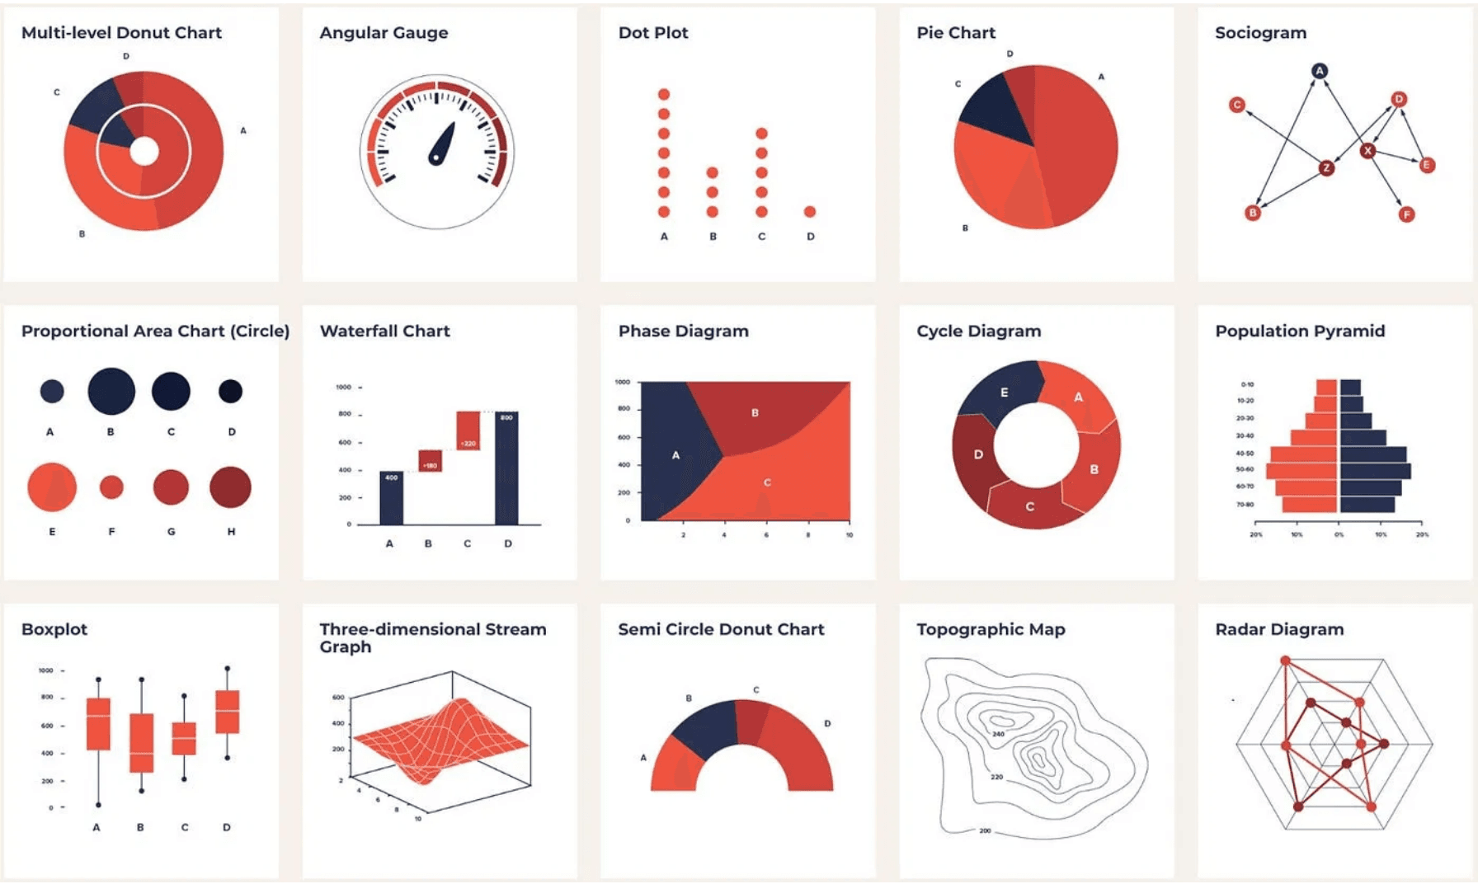
Univariate Analysis (One Variable)
•
Goal:
Understand the distribution of a single feature independently.
Numerical Data
–
Histogram:
View shape (Normal, Skewed)
–
Box Plot:
Spot outliers & quartiles
–
Density Plot (KDE):
Smooth probability curve
Categorical Data
–
Bar Chart:
Count/Frequency of each category
–
Pie Chart:
(Use sparingly) Proportions
Module 04
Working with Data & EDA (2026 Edition) • Classic ML

Slide 15
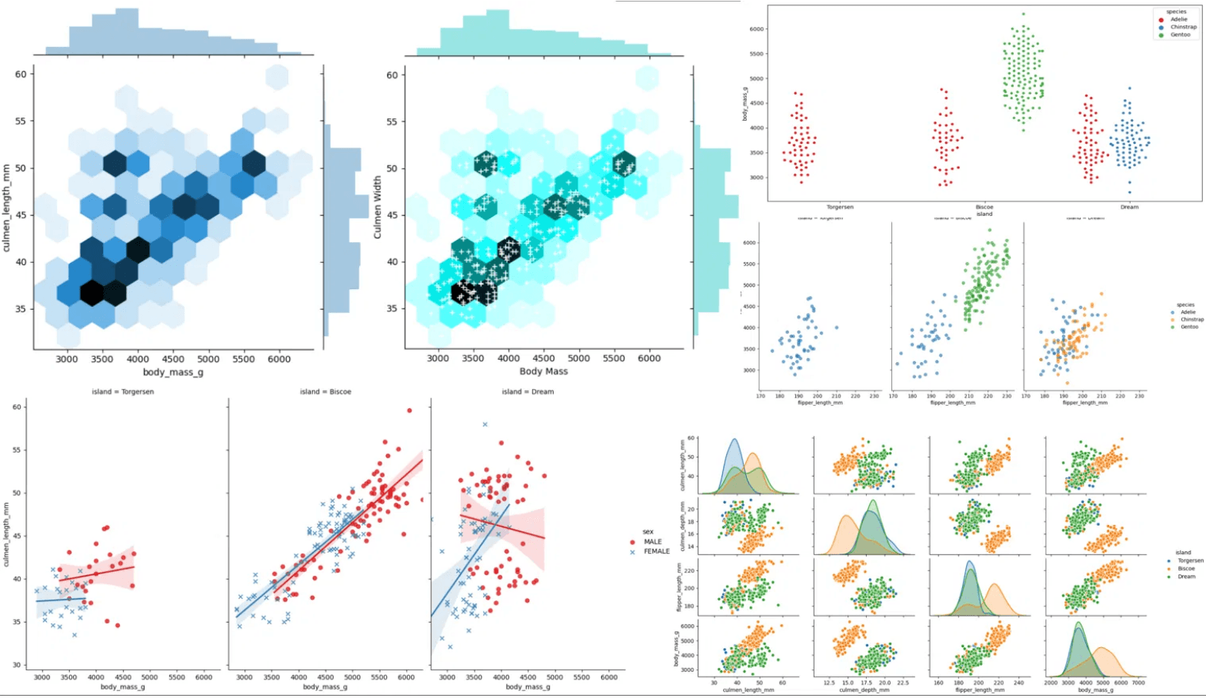
Bivariate Analysis (Two Variables)
Numerical vs. Numerical
•
Scatter Plot:
Shows linear/non-linear patterns
•
Correlation Heatmap:
Strength of relationship
Numerical vs. Categorical
•
Box Plot:
Compare distributions across groups
•
Violin Plot:
Density + Box plot combined
Categorical vs. Categorical
•
Stacked Bar Chart:
Proportions within groups
•
Crosstab Heatmap:
Frequency of combinations
Module 04
Working with Data & EDA (2026 Edition) • Classic ML

Slide 16
Multivariate Analysis
Finding complex interactions between 3 or more variables.
1. Color (Hue)
2. Size (Bubble)
Add a categorical dimension to a 2D scatter plot using color.
Add a numerical dimension by varying the size of points.
hue='Survived'
size='Fare'
3. Pair Plots
4. Facet Grids
Visualize relationships between ALL numerical pairs at once.
Create small multiples (separate charts) for each category.
sns.pairplot(df)
sns.FacetGrid(...)
Module 04
Working with Data & EDA (2026 Edition) • Classic ML

Slide 17
Understanding Your Target Variable
The target variable is the most important feature to analyze first.
Classification
Regression
Check: Class Balance
Check: Distribution
•
Are classes evenly distributed?
•
Is the target normally distributed?
•
Imbalance Risk:
Ignoring minority class.
•
Skewness Risk:
Outliers skew mean.
•
Accuracy is misleading here.
•
May need Log Transformation.
Class 0
Class 1
df['target'].value_counts()
sns.histplot(df['target'])
Module 04
Working with Data & EDA (2026 Edition) • Classic ML

Slide 18
Feature-Target Relationships
The goal is to identify which features actually drive the prediction.
Numerical Target (Regression)
Categorical Target (Classification)
Look For
Look For
Linear or non-linear trends (Does X go up when Y goes up?)
Separation between classes (Is the distribution different?)
Key Metric
Key Metric
Correlation Coefficient (r)
Difference in Means / Medians
Visual Tool
Visual Tool
sns.scatterplot(x=feat, y=target)
sns.boxplot(x=target, y=feat)
Module 04
Working with Data & EDA (2026 Edition) • Classic ML

Slide 19
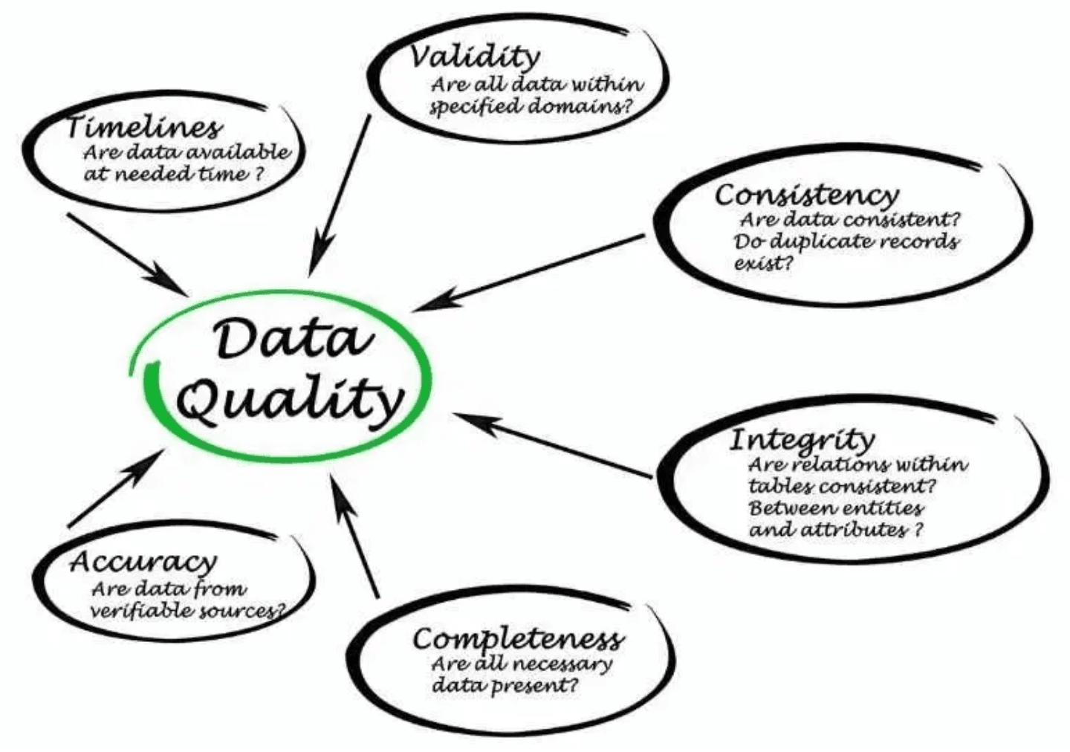
Common Data Quality Issues
•
Duplicates:
Exact or partial copies
Distorts statistics and biases the model.
•
Inconsistent Categories:
"USA", "usa", "U.S.A." are treated as 3 different things.
•
Impossible Values:
Age = -5, Height = 0. Sanity checks failed.
•
Scale Differences:
Salary (100,000) vs Age (30). Large numbers dominate.
Module 04
Working with Data & EDA (2026 Edition) • Classic ML

Slide 20
Data Leakage
The Silent Killer
When information from outside the training dataset (like the test set or future data) is used to create the model.
Common Causes (The Mistake)
Prevention (The Fix)
•
Preprocessing the
entire dataset
•
Golden Rule:
Split Data FIRST.
before split (e.g., scaling, imputing).
•
Fit scalers/imputers ONLY on
train
.
•
Features that proxy the target (e.g.,
•
Transform test using training params.
TransactionID
leaks time).
•
Sanity check:
100% accuracy?
Be suspicious.
•
Time travel: using
future data
.
Module 04
Working with Data & EDA (2026 Edition) • Classic ML

Slide 21
Tools for EDA
The Python Ecosystem
Pandas
Plotly
The backbone of data manipulation. Great for quick checks and basic plots.
Interactive visualizations. Great for exploring dense data.
df.describe(), df.plot()
px.scatter(df, x='a', y='b')
Matplotlib
Auto-EDA Tools
The foundation. Powerful and customizable, but verbose code.
Generate comprehensive reports in one line of code. (Sweetviz, YData Profiling)
plt.hist(df['age'])
profile = ProfileReport(df)
Seaborn
High-level interface for statistical graphics. Beautiful defaults.
sns.boxplot(x='class', y='age')
Module 04
Working with Data & EDA (2026 Edition) • Classic ML

Slide 22
EDA Best Practices
01
Start Simple
02
Visualize First
Always begin with Univariate Analysis. Understand each variable in isolation before looking for complex relationships.
Never trust summary statistics alone. Mean and variance can hide distributions (e.g., Anscombe's Quartet). Plot the data.
03
Document Insights
04
Reproducibility
Don't just write code. Use Markdown cells to record what you see, what it implies, and what questions it raises.
Ensure your analysis is a linear, runnable script or notebook. Avoid manual edits in Excel. Your future self will thank you.
Module 04
Working with Data & EDA (2026 Edition) • Classic ML

Slide 23
From EDA to Feature Engineering
EDA is not just about observation. It is the blueprint for how you will transform your data for the model.
EDA Insight
→
Action
"Date" column is a string object
Extract Year, Month, Day,
Is_Weekend
EDA Insight
→
Action
Target variable is highly skewed
Apply Log Transformation
EDA Insight
→
Action
"Cabin" column has 70% missing values
Create binary flag "Has_Cabin"
Action
EDA Insight
→
Create interaction feature
"Fare" and "Class" are correlated
(Fare_Per_Person)
Module 04
Working with Data & EDA (2026 Edition) • Classic ML

Slide 24
Real-World Example: Titanic
What our EDA revealed about survival patterns.
Demographics
Socioeconomic
Data Quality
"Women and children first."
"Money matters."
"Gaps in the record."
•
Female Survival: ~74%
•
1st Class: Highest survival.
•
Cabin: ~77% missing. Too sparse?
•
Male Survival: ~18%
•
3rd Class: Lowest survival.
•
Age: Children < 10 had higher survival rates.
•
Fare: Highly skewed distribution (long tail).
•
Age: ~20% missing.
•
Embarked: Only 2 missing.
Implication
Implication
Implication
Sex and Age are critical features.
Pclass is a strong predictor. Fare needs log transform.
Drop 'Cabin'. Impute 'Age' using median.
Module 04
Working with Data & EDA (2026 Edition) • Classic ML

Slide 25
Common EDA Mistakes
1. The "Black Box" Approach
Skipping EDA to jump straight into modeling. Garbage In, Garbage Out. You cannot model what you do not understand.
2. Blind Deletion
Dropping missing values or outliers without investigation. Often, the presence or absence of something (missing/not-missing) signals something (e.g., a user declining to answer).
3. Trusting Summary Statistics
Relying solely on Mean and Standard Deviation. Averages hide skewness, bimodality, and outliers. Always visualize.
4. Ignoring Domain Knowledge
Treating numbers as just numbers. You must understand the real-world context (e.g., negative age is impossible, but -1 might mean "unknown").
Module 04
Working with Data & EDA (2026 Edition) • Classic ML

Slide 26
When to Stop EDA?
✓
Data Quality:
You have identified and handled missing values, duplicates, and errors.
✓
Distributions:
You know which features are skewed and need transformation.
✓
Relationships:
You have a hypothesis about which features drive the target.
✓
Action Plan:
You are ready to engineer features and select a model.
The Golden Rule
EDA is never truly "finished." It is an iterative process.
If your model performs poorly, you will return to EDA to find out why.
Module 04
Working with Data & EDA (2026 Edition) • Classic ML

Slide 27
EDA Checklist
1. Data Health
2. Deep Dive
✓
Check shape & data types .info()
✓
Univariate plots (Histograms, Box plots)
✓
Identify missing values .isnull().sum()
✓
Target variable analysis (Skew/Balance)
✓
Check for duplicates .duplicated()
✓
Correlation matrix .corr()
✓
Summary statistics .describe()
✓
Bivariate plots (Scatter, Box by Class)
Module 04
Working with Data & EDA (2026 Edition) • Classic ML

Slide 28
This Week's Lab
Mission Objective
Perform a complete Exploratory Data Analysis on the Titanic dataset to identify survival factors.
01
Load data and inspect structure (head, info, describe).
02
Visualize distributions (Univariate Analysis).
03
Explore relationships between features and survival (Bivariate).
04
Identify missing values and propose handling strategies.
05
Deliverable:
A Jupyter Notebook with code + markdown insights.
Module 04
Working with Data & EDA (2026 Edition) • Classic ML

Slide 29
Key Takeaways
•
EDA is Mandatory:
You cannot model what you do not understand. No shortcuts.
•
Data Quality First:
Fix missing values, outliers, and duplicates before training.
•
Visualize Everything:
Summary statistics can lie. Plots reveal the truth.
•
Actionable Insights:
EDA is the blueprint for Feature Engineering.
Module 04
Working with Data & EDA (2026 Edition) • Classic ML

